Slide 1
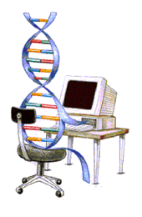
Genetic Algorithms
Prof. Dr. Md. Aminul Haque Akhand
Dept. of CSE, KUET
Source
    Presentation of Dr. Chhavi Kashyap
    Presentation of Dr. Son Kuswadi
    Others

Slide 2

Overview
Introduction To Genetic Algorithms (GAs)
GA Operators and Parameters
Application of Genetic Algorithms
Summary

Slide 3
References
D. E. Goldberg, ‘Genetic Algorithm In Search, Optimization And Machine Learning’, New York: Addison – Wesley (1989)
John H. Holland ‘Genetic Algorithms’, Scientific American Journal, July 1992.
Kalyanmoy Deb, ‘An Introduction To Genetic Algorithms’, Sadhana, Vol. 24 Parts 4 And 5.
D. Whitley, et al, ‘Traveling Salesman And Sequence Scheduling: Quality Solutions Using Genetic Edge Recombination’, Handbook Of Genetic Algorithms, New York
Jason Brownlee, “Clever Algorithms - Nature-Inspired Programming Recipes” 2011.
WEBSITES
www.iitk.ac.in/kangal www.genetic-programming.com

Slide 4
Introduction To Genetic Algorithms (GAs)

Slide 5
History Of Genetic Algorithms
“Evolutionary Computing” was introduced in the 1960s by I. Rechenberg.
John Holland wrote the first book on Genetic Algorithms ‘Adaptation in Natural and Artificial Systems’ in 1975.
In 1992 John Koza used genetic algorithm to evolve programs to perform certain tasks. He called his method “Genetic Programming”.

Slide 6
“It is not the strongest of the species that survives, nor the most intelligent that survives. It is the one that is the most adaptable to change.”
-------- Charles Darwin (12/02/1809 – 19/04/1882)

Slide 7
Basic Idea Of Principle Of Natural Selection
“Select The Best, Discard The Rest”
Notes:
Darwin’s principle of Natural Selection can be stated very simply as “ select the best and discard the rest”.
Let us consider an example. Consider a population of animals of a particular species in a jungle. This population of animals has some animals which are stronger than the others and have characteristics that help them survive better in that environment as compared to the others. Now, the resources, like food,water,etc in the jungle are limited. So, these animals have to compete with one another for these resources. Ultimately, only the strongest, or fittest individuals survive and the rest perish. In other words, in this “struggle for existence” , nature selects the best, and discards the rest.
Now, these surviving animals mate amongst themselves and propagate their favorable characteristics from one generation to another.
What is mating? At the genetic level it can be seen as the crossover of 2 chrmosomes, one from each parent. They exchange some genetic matter and give rise to the new chromosome of the child that has both the parents’ features.Thus the favorable characteristics of the parents that helped them survive in that environment are propagated from one generation to the next till the species becomes best adapted to it’s environment. This is called evolution.

Slide 8
Darwin’s Principle Of Natural Selection
IF there are organisms that reproduce, and
IF offsprings inherit traits from their progenitors, and
IF there is variability of traits, and
IF the environment cannot support all members of a growing population,
THEN those members of the population with less-adaptive traits (determined by the environment) will die out, and
THEN those members with more-adaptive traits (determined by the environment) will thrive
The result is the evolution of species.

Slide 9
An Example of Natural Selection
Giraffes have long necks.
Giraffes with slightly longer necks could feed on leaves of higher branches when all lower ones had been eaten off.
→ They had a better chance of survival.
→ Favorable characteristic propagated through generations of giraffes.
→ Now, evolved species has long necks.
NOTE: Longer necks may have been a deviant characteristic (mutation) initially but since it was favorable, was propagated over generations. Now an established trait.
So, some mutations are beneficial.

Slide 10
Evolution Through Natural Selection
Initial Population Of Animals
Struggle For Existence-Survival Of the Fittest
Surviving Individuals Reproduce, Propagate Favorable Characteristics
Millions Of Years
Evolved Species
(Favorable Characteristic Now A Trait Of Species)

Slide 11
What Are Genetic Algorithms (GAs)?175d 145a
Genetic Algorithms are search and optimization techniques based on Darwin’s Principle of Natural Selection.
Notes:
What exactly are Genetic Algorithms?
As the name suggests, Genetic Algorithms or Gas borrow their basic working principle from natural genetics.
Genetic Algorithms are search and optimization methods based on Darwin’s principle of Natural Selection.

Slide 12
Genetic Algorithms Implement Optimization Strategies By Simulating Evolution Of Species Through Natural Selection.

Slide 13
Working Mechanism Of GAs
Begin
Initialize population
Evaluate Solutions
T =0
Optimum Solution?
N
Selection
Y
T=T+1
Stop
Crossover
Mutation
Notes:
GAs implement optimization techniques by simulating this natural law of evolution in the biological world.
We start with a population of randomly generated solutions. Each of these solutions is evaluated to determine how good or bad it is. In other words to determine how “fit” that solution is. We then check a terminating condition, to see if our solutions are good enough? If yes, we stop. If not, we have to optimize the solutions.
So, we select the best solutions from the initial population (selection). This is similar to “natural selection”.
Then we allow these good solutions to exchange their information, in order to get even better solutions. This step is similar to reproduction among animals or crossover among chromosomes and is called “cross-over”. We may then randomly mutate some small % of the solutions thus obtained after crossover.
Mutation is very imp. It could be a bad thing, it could be a good thing. In the biological sense it mean, making a small change in a gene. In GAs, it means, making a small change to the solution.
Then again, we evaluate each of the solutions, and check the termination condition. As you see , this is an optimization method.

Slide 14
Simple Genetic Algorithm 175d
Simple_Genetic_Algorithm()
{
Initialize the Population;
Calculate Fitness Function;
While(Fitness Value != Optimal Value)
{
Selection;//Natural Selection, Survival Of Fittest
Crossover;//Reproduction, Propagate favorable characteristics
Mutation;//Mutation
Calculate Fitness Function;
}
}

Slide 15
Nature to Computer Mapping
Nature | Computer
Population Individual Fitness Chromosome Gene Reproduction | Set of solutions. Solution to a problem. Quality of a solution. Encoding for a Solution. Part of the encoding of a solution. Crossover
Notes:
So after this discussion, it should be clear to you that Gas mimic the natural process of evolution to a large extent. To summarize the similarities , I have a slide here.

Slide 16
GA Operators and Parameters

Slide 17
Encoding
The process of representing the solution in the form of a string that conveys the necessary information.
Just as in a chromosome, each gene controls a particular characteristic of the individual, similarly, each bit in the string represents a characteristic of the solution.
Notes:
The very first step in Gas, is coming up with a random population of solutions. Each of these solutions is represented in the form of a string and this process is called encoding.
Just as we have chromosomes in animals that are made up of a string of genes, similarly the solutions in Gas are represnted in the form of strings, which are made up of characters, each of which stand for and control a particular aspect of the solution.
There are many methods of encoding, the common ones are binary encoding, real encoding ,etc. The method chosen depends on the problem at hand.

Slide 18
Encoding Methods
Binary Encoding – Most common method of encoding. Chromosomes are strings of 1s and 0s and each position in the chromosome represents a particular characteristic of the problem.
Chromosome A
10110010110011100101
Chromosome B
11111110000000011111

Slide 19
Encoding Methods (contd.)
Permutation Encoding – Useful in ordering problems such as the Traveling Salesman Problem (TSP). Example. In TSP, every chromosome is a string of numbers, each of which represents a city to be visited.
Chromosome A
1 5 3 2 6 4 7 9 8
Chromosome B
8 5 6 7 2 3 1 4 9

Slide 20
Encoding Methods (contd.) 145b (with tree encoding)
Value Encoding – Used in problems where complicated values, such as real numbers, are used and where binary encoding would not suffice.
Good for some problems, but often necessary to develop some specific crossover and mutation techniques for these chromosomes.
Chromosome A
1.235 5.323 0.454 2.321 2.454
Chromosome B
(left), (back), (left), (right), (forward)

Slide 21
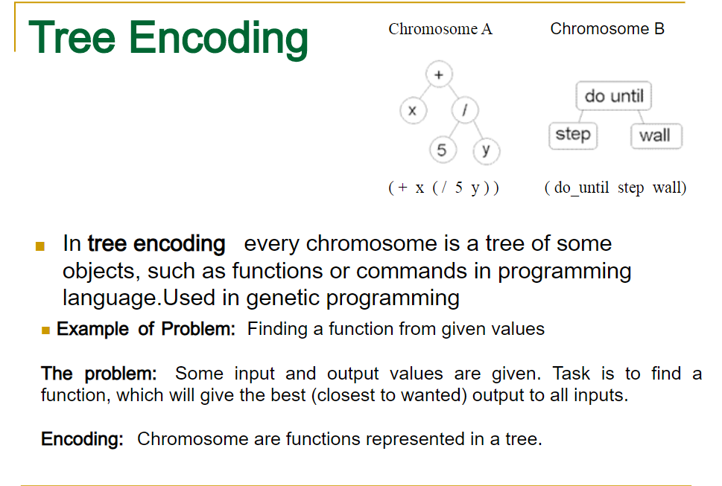

Slide 22
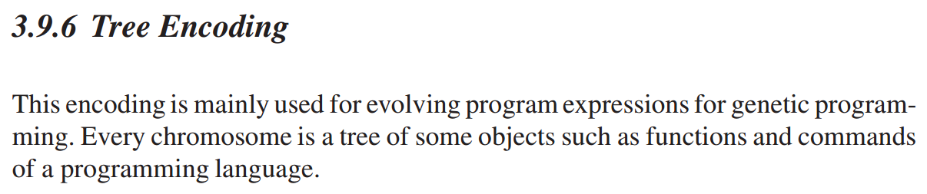
Tree encoding

Slide 23
Fitness Function
A fitness function quantifies the optimality of a solution (chromosome) so that that particular solution may be ranked against all the other solutions.
A fitness value is assigned to each solution depending on how close it actually is to solving the problem.
Ideal fitness function correlates closely to goal + quickly computable.
Example. In TSP, f(x) is sum of distances between the cities in solution. The lesser the value, the fitter the solution is.

Slide 24
Recombination
The process that determines which solutions are to be preserved and allowed to reproduce and which ones deserve to die out.
The primary objective of the recombination operator is to emphasize the good solutions and eliminate the bad solutions in a population, while keeping the population size constant.
“Selects The Best, Discards The Rest”.
“Recombination” is different from “Reproduction”.

Slide 25
Recombination
Identify the good solutions in a population.
Make multiple copies of the good solutions.
Eliminate bad solutions from the population so that multiple copies of good solutions can be placed in the population.

Slide 26
Roulette Wheel Selection 176c,155d
Each current string in the population has a slot assigned to it which is in proportion to it’s fitness.
We spin the weighted roulette wheel thus defined n times (where n is the total number of solutions).
Each time Roulette Wheel stops, the string corresponding to that slot is created.
Strings that are fitter are assigned a larger slot and hence have a better chance of appearing in the new population.

Slide 27
Example Of Roulette Wheel Selection
No. | String | Fitness | % Of Total
1 | 01101 | 169 | 14.4
2 | 11000 | 576 | 49.2
3 | 01000 | 64 | 5.5
4 | 10011 | 361 | 30.9
Total |  | 1170 | 100.0

Slide 28
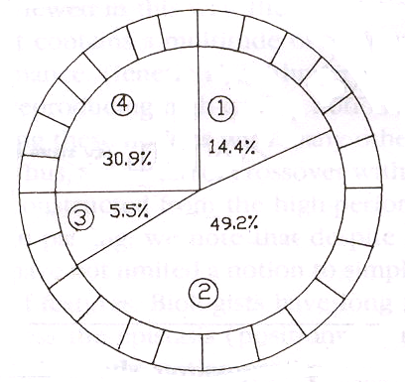
Roulette Wheel For Example

Slide 29

Tournament selection

Slide 30
Crossover 145c
It is the process in which two chromosomes (strings) combine their genetic material (bits) to produce a new offspring which possesses both their characteristics.
Two strings are picked from the mating pool at random to cross over.
The method chosen depends on the Encoding Method.

Slide 31
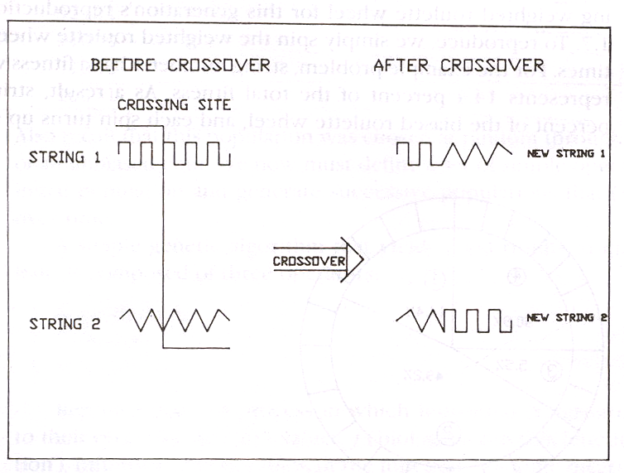
Crossover Methods
Single Point Crossover- A random point is chosen on the individual chromosomes (strings) and the genetic material is exchanged at this point.

Slide 32
Crossover Methods (contd.)
Single Point Crossover
Chromosome1 | 11011 | 00100110110
Chromosome 2 | 11011 | 11000011110
Offspring 1 | 11011 | 11000011110
Offspring 2 | 11011 | 00100110110

Slide 33
Crossover Methods (contd.)
Two-Point Crossover- Two random points are chosen on the individual chromosomes (strings) and the genetic material is exchanged at these points.
Chromosome1 | 11011 | 00100 | 110110
Chromosome 2 | 10101 | 11000 | 011110
Offspring 1 | 10101 | 00100 | 011110
Offspring 2 | 11011 | 11000 | 110110
NOTE: These chromosomes are different from the last example.

Slide 34
Crossover Methods (contd.)
Uniform Crossover- Each gene (bit) is selected randomly from one of the corresponding genes of the parent chromosomes.
Chromosome1 | 11011 | 00100 | 110110
Chromosome 2 | 10101 | 11000 | 011110
Offspring | 10111 | 00000 | 110110
NOTE: Uniform Crossover yields ONLY 1 offspring.

Slide 35
Crossover (contd.)
Crossover between 2 good solutions MAY NOT ALWAYS yield a better or as good a solution.
Since parents are good, probability of the child being good is high.
If offspring is not good (poor solution), it will be removed in the next iteration during “Selection”.

Slide 36
Elitism 155e
Elitism is a method which copies the best chromosome to the new offspring population before crossover and mutation.
When creating a new population by crossover or mutation the best chromosome might be lost.
Forces GAs to retain some number of the best individuals at each generation.
Has been found that elitism significantly improves performance.

Slide 37
Mutation 155c
It is the process by which a string is deliberately changed so as to maintain diversity in the population set.
We saw in the giraffes’ example, that mutations could be beneficial.
Mutation Probability- determines how often the parts of a chromosome will be mutated.

Slide 38
Example Of Mutation
For chromosomes using Binary Encoding, randomly selected bits are inverted.
Offspring | 11011 00100 110110
Mutated Offspring | 11010 00100 100110
NOTE: The number of bits to be inverted depends on the Mutation Probability.

Slide 39
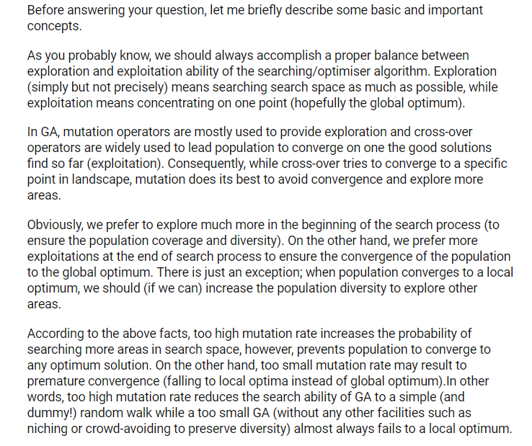

Slide 40

Advantages Of GAs
Global Search Methods: GAs search for the function optimum starting from a population of points of the function domain, not a single one. This characteristic suggests that GAs are global search methods. They can, in fact, climb many peaks in parallel, reducing the probability of finding local minima, which is one of the drawbacks of traditional optimization methods.

Slide 41
Advantages of GAs (contd.)
Blind Search Methods: GAs only use the information about the objective function. They do not require knowledge of the first derivative or any other auxiliary information, allowing a number of problems to be solved without the need to formulate restrictive assumptions. For this reason, GAs are often called blind search methods.

Slide 42
Advantages of GAs (contd.)
GAs use probabilistic transition rules during iterations, unlike the traditional methods that use fixed transition rules.
This makes them more robust and applicable to a large range of problems.

Slide 43
Advantages of GAs (contd.)
GAs can be easily used in parallel machines- Since in real-world design optimization problems, most computational time is spent in evaluating a solution, with multiple processors all solutions in a population can be evaluated in a distributed manner. This reduces the overall computational time substantially.

Slide 44
Simple Example
(Goldberg98)
Simple problem: max x² over {0,1,…,31}
GA approach:
  Representation: binary code, e.g. 01101 ↔ 13
  Population size: 4
  1-point xover, bitwise mutation
  Roulette wheel selection
  Random initialization
We show one generational cycle done by hand

Slide 45
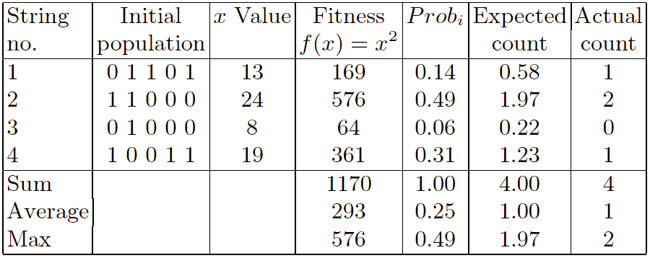
Selection 155b

Slide 46
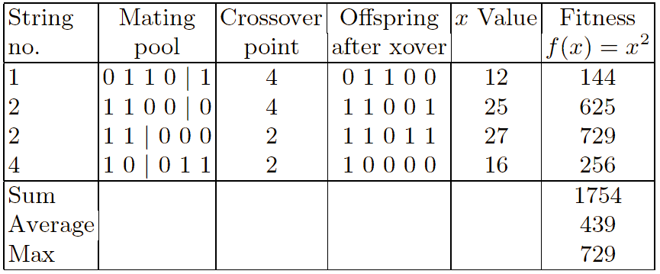
Crossover

Slide 47
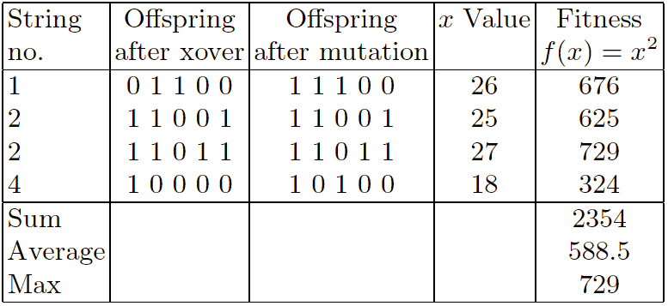
Mutation 155c

Slide 48
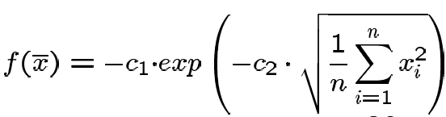
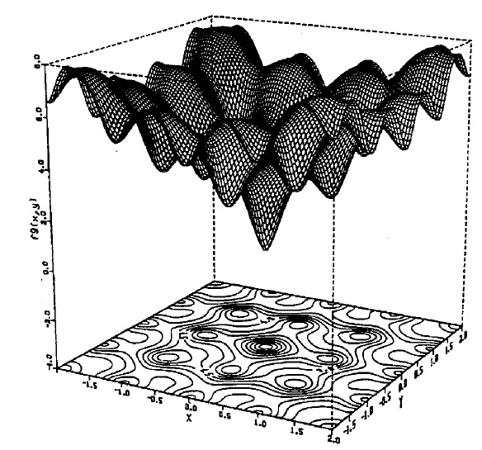

Hard Problems
Solution of f(x)=x² is easy to find and not realistic for GA
Many problems occur as real valued problems, e.g. continuous parameter optimization f : ℜ ^{n} → ℜ
Illustration: Ackley’s function (often used in EC)

Slide 49
Genetic Algorithms To Solve The Traveling Salesman Problem (TSP)

Slide 50
The Problem
The Traveling Salesman Problem is defined as:
‘We are given a set of cities and a symmetric distance matrix that indicates the cost of travel from each city to every other city.
The goal is to find the shortest circular tour, visiting every city exactly once, so as to minimize the total travel cost, which includes the cost of traveling from the last city back to the first city’.
Traveling Salesman Problem

Slide 51
Encoding
I represent every city with an integer .
Consider 6 Indian cities –
Mumbai, Nagpur , Calcutta, Delhi , Bangalore and Chennai and assign a number to each.
Mumbai 1
Nagpur 2
Calcutta 3
Delhi 4
Bangalore 5
Chennai 6

Slide 52
Encoding (contd.)
Thus a path would be represented as a sequence of integers from 1 to 6.
The path [1 2 3 4 5 6 ] represents a path from Mumbai to Nagpur, Nagpur to Calcutta, Calcutta to Delhi, Delhi to Bangalore, Bangalore to Chennai, and finally from Chennai to Mumbai.
This is an example of Permutation Encoding as the position of the elements determines the fitness of the solution.

Slide 53
Fitness Function
The fitness function will be the total cost of the tour represented by each chromosome.
This can be calculated as the sum of the distances traversed in each travel segment.
The Lesser The Sum, The Fitter The Solution Represented By That Chromosome.

Slide 54
Distance/Cost Matrix For TSP
 | 1 | 2 | 3 | 4 | 5 | 6
1 | 0 | 863 | 1987 | 1407 | 998 | 1369
2 | 863 | 0 | 1124 | 1012 | 1049 | 1083
3 | 1987 | 1124 | 0 | 1461 | 1881 | 1676
4 | 1407 | 1012 | 1461 | 0 | 2061 | 2095
5 | 998 | 1049 | 1881 | 2061 | 0 | 331
6 | 1369 | 1083 | 1676 | 2095 | 331 | 0
Cost matrix for six city example.
Distances in Kilometers

Slide 55
Fitness Function (contd.)
So, for a chromosome [4 1 3 2 5 6], the total cost of travel or fitness will be calculated as shown below
Fitness = 1407 + 1987 + 1124 + 1049 + 331+ 2095
= 7993 kms.
Since our objective is to Minimize the distance, the lesser the total distance, the fitter the solution.

Slide 56
Selection Operator Q
May use Tournament Selection.
As the name suggests tournaments are played between two solutions and the better solution is chosen and placed in the mating pool.
Two other solutions are picked again and another slot in the mating pool is filled up with the better solution.

Slide 57
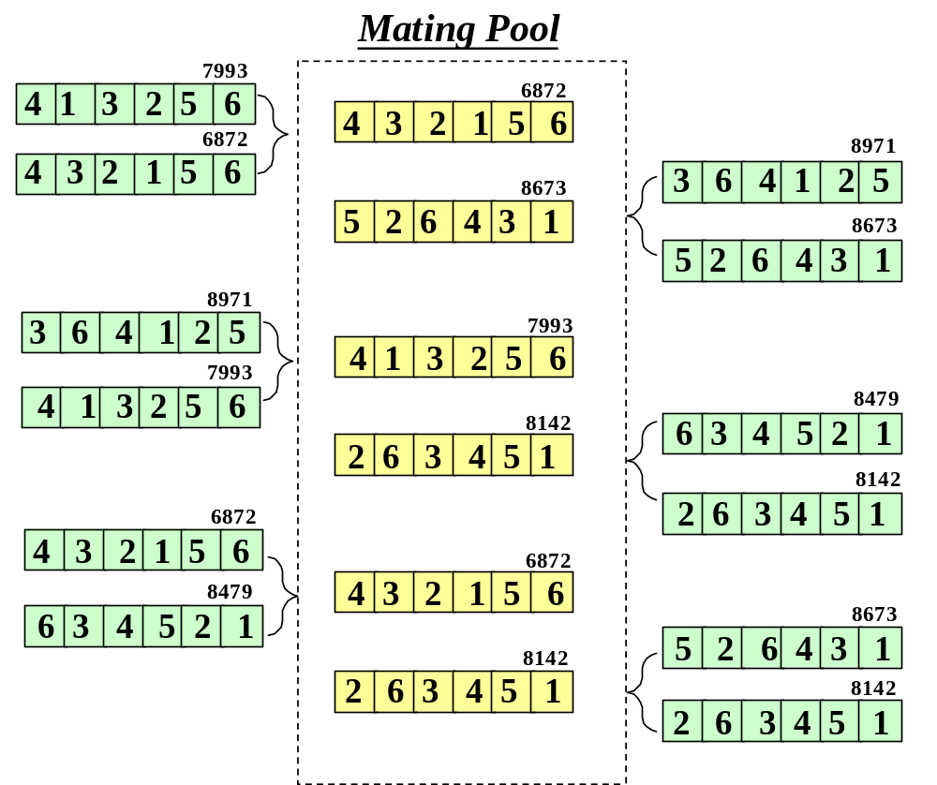
Tournament Selection (contd.)

Slide 58
Why we cannot use single-point crossover: 176b
Single point crossover method randomly selects a crossover point in the string and swaps the substrings.
This may produce some invalid offsprings as shown below.
4 | 1 | 3 | 2 | 5 | 6
4 | 1 | 3 | 1 | 5 | 6
4 | 3 | 2 | 1 | 5 | 6
4 | 3 | 2 | 2 | 5 | 6

Slide 59
Crossover Operator 145c
Used the Enhanced Edge Recombination operator (T.Starkweather, et al, 'A Comparison of Genetic Sequencing Operators, International Conference of GAs, 1991).
This operator is different from other genetic sequencing operators in that it emphasizes adjacency information instead of the order or position of items in the sequence.
The algorithm for the Edge-Recombination Operator involves constructing an Edge Table first.

Slide 60
Edge Table
The Edge Table is an adjacency table that lists links into and out of a city found in the two parent sequences.
If an item is already in the edge table and we are trying to insert it again, that element of a sequence must be a common edge and is represented by inverting it's sign.

Slide 61
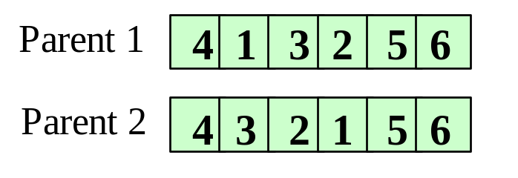
Finding The Edge Table
1
4
3
2
5
2
-3
5
1
3
1
-2
4
4
-6
1
3
5
1
2
-6
6
-5
-4

Slide 62
Enhanced Edge Recombination Algorithm
Choose the initial city from one of the two parent tours. (It can be chosen randomly as according to criteria outlined in step 4). This is the current city.
Remove all occurrences of the current city from the left hand side of the edge table.( These can be found by referring to the edge-list for the current city).
If the current city has entries in it's edge-list, go to step 4 otherwise go to step 5.
Determine which of the cities in the edge-list of the current city has the fewest entries in it's own edge-list. The city with fewest entries becomes the current city. In case a negative integer is present, it is given preference. Ties are broken randomly. Go to step 2.
If there are no remaining unvisited cities, then stop. Otherwise, randomly choose an unvisited city and go to step 2.

Slide 63
Example Of Enhanced Edge Recombination Operator(Q-18.6a)
Step 1
Step 2
1
4
3
2
5
1
3
2
5
2
-3
5
1
2
-3
5
1
3
1
-2
4
3
1
-2
4
-6
1
3
4
-6
1
3
5
3
2
-6
5
3
2
-6
6
-5
-4
6
-5
4
4 6

Slide 64
Example Of Enhanced Edge Recombination Operator (contd.)
Step 3
Step 4
1
3
2
5
1
3
2
2
-3
5
1
2
-3
1
3
1
-2
3
1
-2
4
1
3
4
1
3
5
3
2
5
3
2
6
-5
6
4 6 5
4 6 5 1

Slide 65
Example Of Enhanced Edge Recombination Operator (contd.)
Step 5
Step 6
1
3
2
1
2
2
-3
2
3
-2
3
-2
4
3
4
5
3
2
5
2
6
6
4 6 5 1 3
4 6 5 1 3 2

Slide 66
Mutation Operator 145c
The mutation operator induces a change in the solution, so as to maintain diversity in the population and prevent Premature Convergence.
In our project, we mutate the string by randomly selecting any two cities and interchanging their positions in the solution, thus giving rise to a new tour.
4
1
3
2
5
6
4
5
3
2
1
6

Slide 67
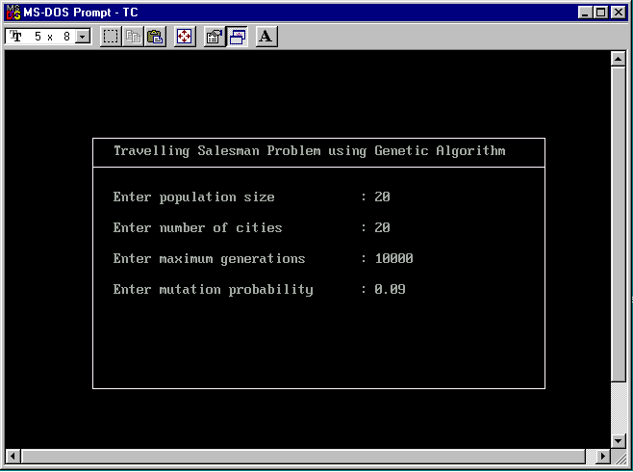
Input To Program

Slide 68
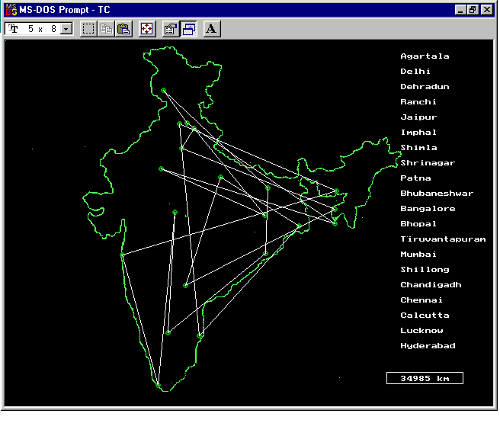
Initial Output For 20 cities : Distance=34985 km
Initial Population

Slide 69
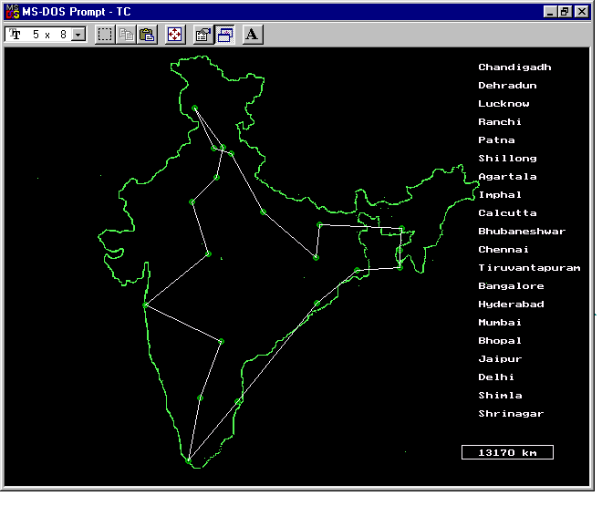
Final Output For 20 cities : Distance=13170 km
Generation 4786

Slide 70
Other Typical applications:
When to use it?
machine learning
timetabling, scheduling
data mining
robot trajectory
etc.
optimisation problems
designing neural networks
strategy planning
evolving programs

Slide 71
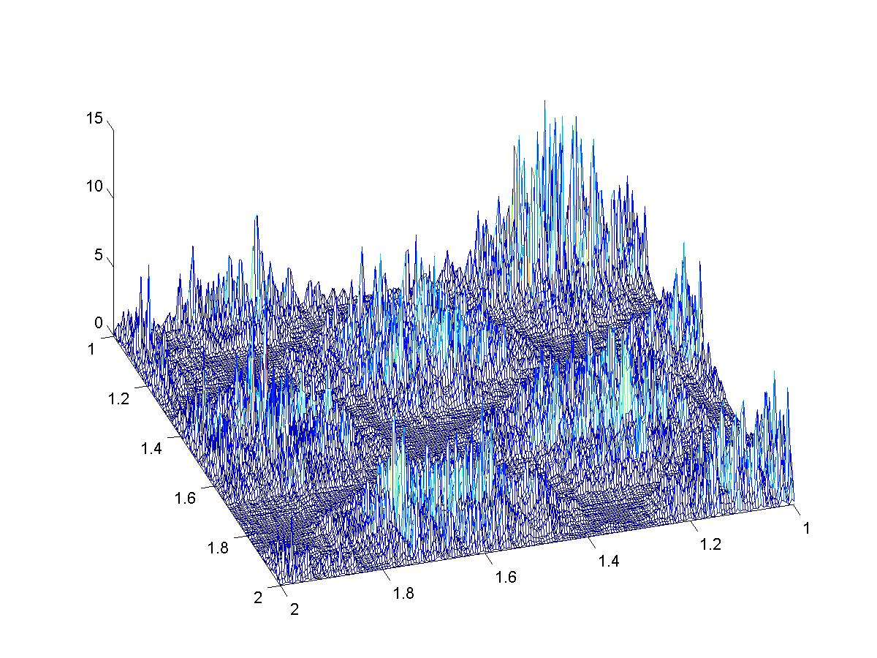
Extremes of multimodal functions

Slide 72
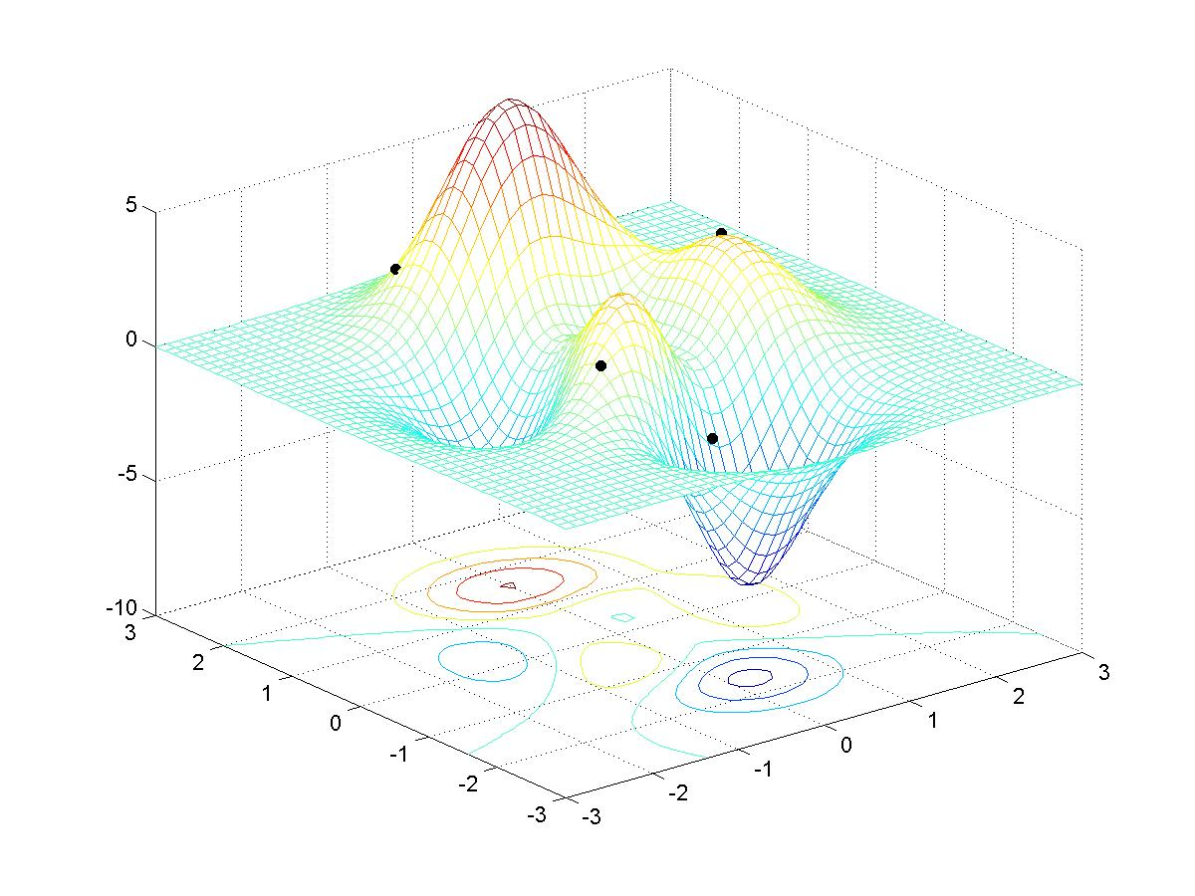
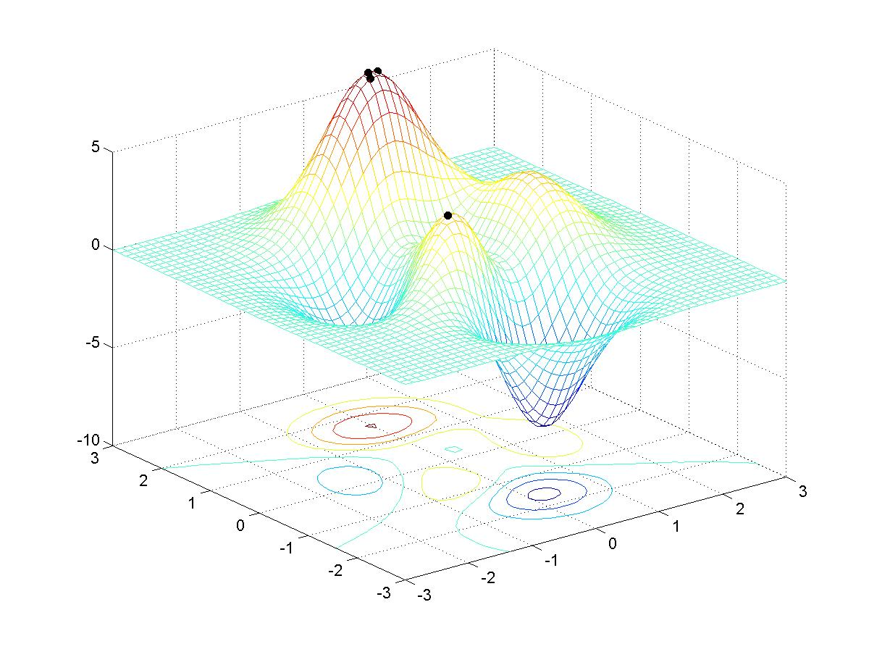
Extremes of multimodal functions

Slide 73
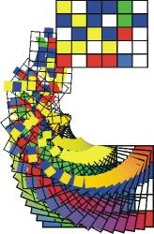
Timetabling
Each chromosome represents
a timetable
A random population of feasible
timetables is created
Each timetable is evaluated according to chosen criteria
Timetables are selected for reproduction
Crossover and mutation operators are used to produce offspring
The population increasingly consists of “good” timetables

Slide 74
Evolution of Strategies -
Game Playing
Each chromosome represents different strategies for playing the game
Initial population is generated randomly
During the selection process each strategy is required to play a certain number of games against other strategies
The strategies with the most wins are selected for reproduction
The population increasingly consists of “good” strategies

Slide 75
Rule Discovery
SAMUEL system discovers rules by which a slower but more manoeuvrable aircraft can evade a faster but less agile missile until the missile runs out of fuel
The aircraft can sense the range, speed, heading and bearing of the missile
Rules are of a fairly uniform sort, such as to turn left by 90 degrees if the missile parameters are lie within certain intervals

Slide 76
Rule Discovery
Chromosomes are ordered sets of possible rules (if situation x occurs do action encoded within x-th gene)
Fitness evaluation is by simulation (it is examined for how long the aircraft can evade the missile using particular set of rules)
It takes hours to evaluate initial population !

Slide 77
Criminal suspect recognition
It is easy to identify a criminal from photo but hard to describe his or her features
It is difficult to generate even from computer library of visual features
Idea to use genetic algorithms to help witnesses in the identification of criminal suspects

Slide 78




Criminal suspect recognition
Faceprints
randomly generates 20 faces on
a computer screen
witness evaluates each face
on a 10 point scale
GA generates additional faces from 5 building blocks: eyes, mouth, nose, hair and chin (7-bit string each)
Chromosome is a 35-bit binary string (34 billion faces)
Witness rates successive generations with 10 point scale
Convergence often occurs after 20 generations

Slide 79

Boeing 777
The engines were designed by classical techniques with the emphasis on efficient fuel consumption
Genetic algorithms were used to fine-tuning of some parameters of the already designed engines
Due to their utilization at this stage the consumption of fuel has been reduced by 2,5%
(operating cost savings cca 2 mil USD at one plane per year)

Slide 80
Summary

Slide 81
Genetic Algorithms (GAs) implement optimization strategies based on simulation of the natural law of evolution of a species by natural selection
The basic GA Operators are:
Encoding
Recombination
Crossover
Mutation
GAs have been applied to a variety of function optimization problems, and have been shown to be highly effective in searching a large, poorly defined search space even in the presence of difficulties such as high-dimensionality, multi-modality, discontinuity and noise.

Slide 82
Questions ?

